Slide 1
People
Ministries
Sacraments
Geography
Books
Aerobics
$100
$100
$100
$100
$100
$100
$200
$200
$200
$200
$200
$200
$300
$300
$300
$300
$300
$300
$400
$400
$400
$400
$400
$400
$500
$500
$500
$500
$500
$500

Slide 2
The head priest at a church.
Return to Main Board
Answer

Slide 3
Who is the rector?
Return to Main Board

Slide 4
The person who leads the music.
Return to Main Board
Answer

Slide 5
Who is the organist and/or choirmaster?
Return to Main Board

Slide 6
The men and women who are elected to make decisions about the church.
Return to Main Board
Answer

Slide 7
Who are the Vestry?
Return to Main Board

Slide 8
The person who reads the Gospel.
Return to Main Board
Answer

Slide 9
Who is the deacon?
Return to Main Board

Slide 10
The ministers of the church.
Return to Main Board
Answer

Slide 11
Who are all of us?
Return to Main Board

Slide 12
The group that prepares the altar area for worship.
Return to Main Board
Answer

Slide 13
Who are the altar guild?
Return to Main Board

Slide 14
A person who hands out worship bulletins and collects the offering.
Return to Main Board
Answer

Slide 15
What is an usher?
Return to Main Board

Slide 16
The person who reads the Old Testament or New Testament lesson.
Return to Main Board
Answer

Slide 17
Who is the lector?
Return to Main Board

Slide 18
The person who welcomes people as they enter the church.
Return to Main Board
Answer

Slide 19
Who is the greeter?
Return to Main Board

Slide 20
They arrange flowers for the altar.
Return to Main Board
Answer

Slide 21
Who are the flower guild?
Return to Main Board

Slide 22
The person who carries the taper, carries the cross, or helps set the table.
Return to Main Board
Answer

Slide 23
What is an acolyte?
Return to Main Board

Slide 24
The person who carries the cross.
Return to Main Board
Answer

Slide 25
What is the crucifer?
Return to Main Board

Slide 26
The person who says the Eucharistic prayer.
Return to Main Board
Answer

Slide 27
Who is the priest?
Return to Main Board

Slide 28
The person who sets the table.
Return to Main Board
Answer

Slide 29
Who is the liturgist, deacon, or priest?
Return to Main Board

Slide 30
The person who distributes the wine.
Return to Main Board
Answer

Slide 31
What is the chalice bearer?
Return to Main Board

Slide 32
The garment an acolyte wears
Return to Main Board
Answer

Slide 33
What is an alb?
Return to Main Board

Slide 34
The strip of cloth a priest wears around her neck
Return to Main Board
Answer

Slide 35
What is the Episcopal Church?
Return to Main Board

Slide 36
The geographic area that brings nearby parishes together for sharing and mission.
Return to Main Board
Answer

Slide 37
What is a region?
Return to Main Board

Slide 38
.
The Episcopal Church in Connecticut.
Return to Main Board
Answer

Slide 39
What is a diocese?
Return to Main Board

Slide 40
The symbol for this gospel.
The name of a local Episcopal worshipping community.
This symbol of a gospel.
Return to Main Board
Answer

Slide 41
What is a parish
(or mission or congregation)?
Return to Main Board

Slide 42
The blue (or red) book in the pew with hymns in it.
Return to Main Board
Answer

Slide 43
What is the Hymnal 1982?
Return to Main Board

Slide 44
Where the stories of the Old Testament and New Testament are told.
Return to Main Board
Answer

Slide 45
What is the Bible?
Return to Main Board

Slide 46
The hymnal with music from other countries as well as more
Return to Main Board
Answer

Slide 47
What is “Wonder, Love, and Praise”?
Return to Main Board

Slide 48
The name of the African American Episcopal Hymnal.
Return to Main Board
Answer

Slide 49
What is “Lift Every Voice and Sing II”?
Return to Main Board

Slide 50
The book that connects us as Episcopalians in prayer.
Return to Main Board
Answer

Slide 51
What is the Book of Common Prayer?
Return to Main Board

Slide 52
The offertory anthem
Return to Main Board
Answer

Slide 53
What is sit and listen?
Return to Main Board

Slide 54
The sermon.
Return to Main Board
Answer

Slide 55
What is sit?
Return to Main Board

Slide 56
Receiving communion
at the altar rail.
Return to Main Board
Answer

Slide 57
What is kneel?
Return to Main Board

Slide 58
The opening hymn.
Return to Main Board
Answer

Slide 59
What is stand and sing?
Return to Main Board

Slide 60
The Peace
Return to Main Board
Answer

Slide 61
What is shake your neighbor’s hand and say “The Peace of the Lord be with you” or “And also with you”?
Return to Main Board

Slide 62
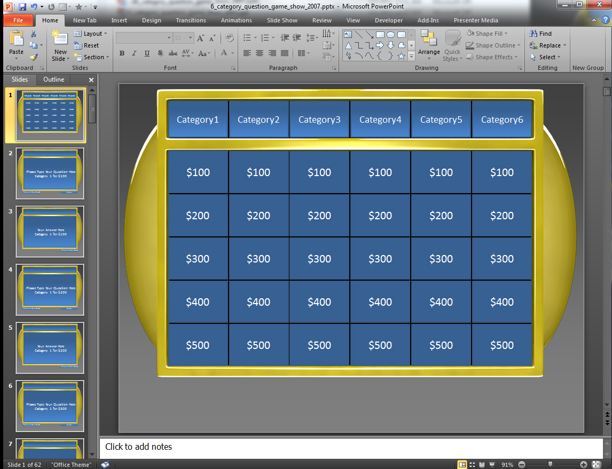
How to use this Template
This template is set up using hyperlinks which jump from slide to slide.
Each panel is linked to a corresponding Question slide which has a panel where you can edit the text and type in your own Question.
Under each Question Slide is an Answer Slide which you can type the answer to your Question.
Here is the Question Slide that contains an area to type your question.
Click the Answer button to jump to that Questions Answer Slide which is the slide directly below.
Here is the Answer Slide that is directly below the Question Slide.
You can also click the Return to Main Board button if you choose not to reveal the answer.
*note* You can access Slide Show Mode by hitting the F5 key on your keyboard or going to the Slide Show tab in your top menu and selecting From Current Slide.
On the Answer Slide click the Return to Main Board button to return to the main Category Board.

Slide 63
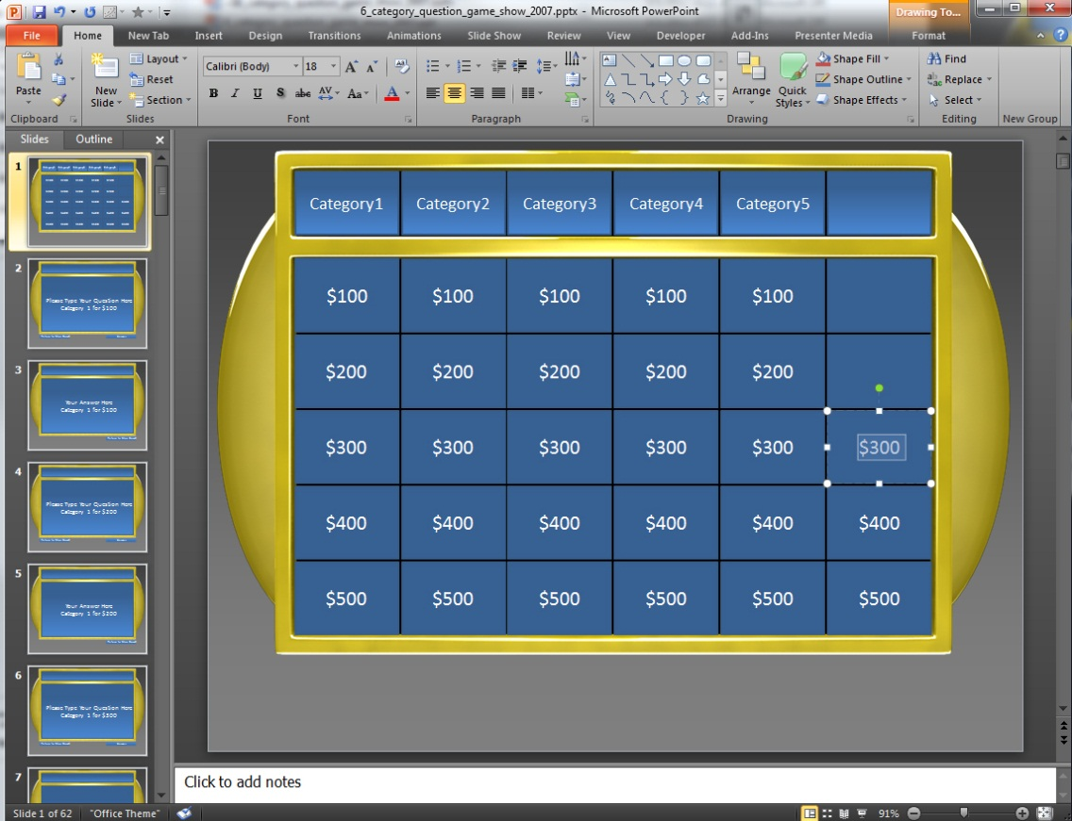
Making Panels Inactive
You can make panels inactive simply by selecting the TEXT and hitting delete which will leave the panel blank.
Once you have deleted the Panels you want you will want to go delete the corresponding Question and Answer Slides.
Example: If were deleted the text on these panels.
We would then need to go delete the corresponding Question and Answer Slides for Category4 $500, Category5 $500, Category6 $500.
*note*You can multiple slide at once by holding Shift while selecting slides.
Say if you wanted to delete all of Category6 Question & Answer slides you click the top slide you want to delete and hold shift and click the bottom slide and all the slides in between will be selected.

Slide 64
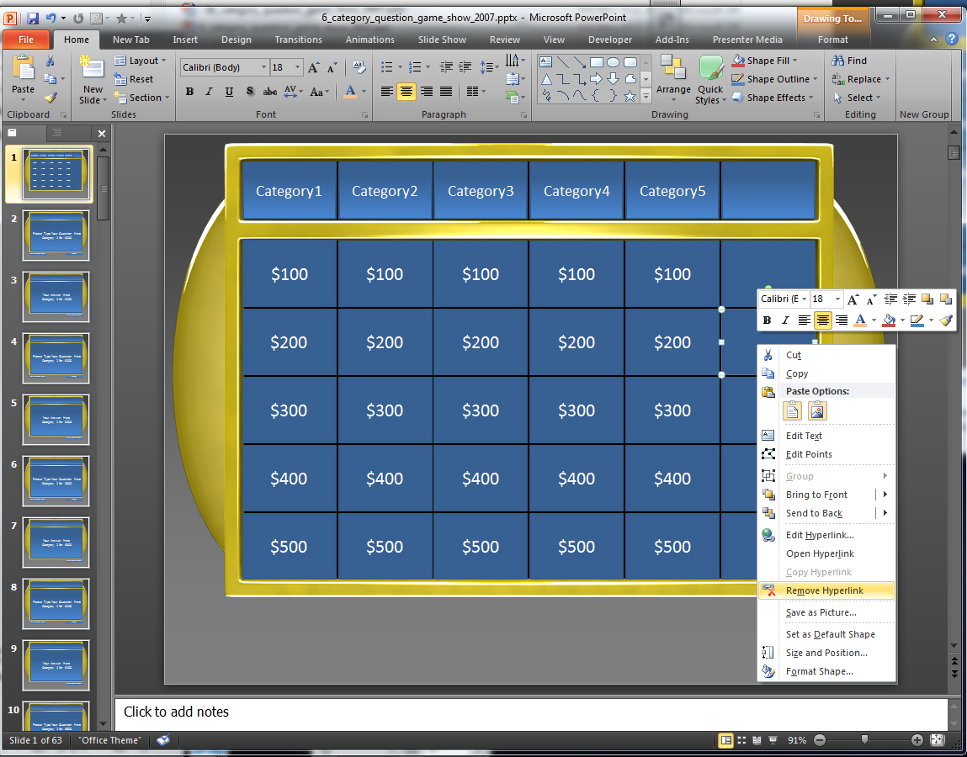
Making Panels Inactive Alternative
If you do not want to delete any of your slides Question and Answer Slides and just want to make those panels on the main board inactive, you can right click on the panel and select Remove Hyperlink.
For 2003 users you will need to double right click to find this option.
This will remove the link to the Corresponding Question Slide.

