Slide 1
Playing
with fire
Pots and Pans
People
Dressing Up
Little Things
Seasons
$100
$100
$100
$100
$100
$100
$200
$200
$200
$200
$200
$200
$300
$300
$300
$300
$300
$300
$400
$400
$400
$400
$400
$400
$500
$500
$500
$500
$500
$500

Slide 2
Candles on long sticks carried in and out of the service.
Return to Main Board
Answer

Slide 3
What are tapers?
Return to Main Board

Slide 4
The vessel in which incense is sometimes burned
Return to Main Board
Answer

Slide 5
What is “thurible?”
Return to Main Board

Slide 6
The two candles on the wall to the left of the font.
Return to Main Board
Answer

Slide 7
What are the Mary candles?
Return to Main Board

Slide 8
Where the two tapers are placed.
Return to Main Board
Answer

Slide 9
What is on either side of the ambo/lectern?
Return to Main Board

Slide 10
The candle that is lit first on the altar table.
Return to Main Board
Answer

Slide 11
What is the right side?
Return to Main Board

Slide 12
The wine for Eucharist is put in this cup.
Return to Main Board
Answer

Slide 13
What is the chalice?
Return to Main Board

Slide 14
The plate where we put the bread at Eucharist.
Return to Main Board
Answer

Slide 15
What is the paten?
Return to Main Board

Slide 16
The three things an acolyte holds to help the priest wash her hands.
Return to Main Board
Answer

Slide 17
What is a towel, a bowl and a pitcher of water?
Return to Main Board

Slide 18
The bowl used to collect money.
Return to Main Board
Answer

Slide 19
What is the alms basin?
Return to Main Board

Slide 20
The napkin used used
to wipe the chalice.
Return to Main Board
Answer

Slide 21
What is the purificator?
Return to Main Board

Slide 22
The person who carries the taper, carries the cross or helps set the table.
Return to Main Board
Answer

Slide 23
What is an acolyte?
Return to Main Board

Slide 24
The person who carries the cross.
Return to Main Board
Answer

Slide 25
What is the crucifer?
Return to Main Board

Slide 26
The person who says the Eucharistic prayer.
Return to Main Board
Answer

Slide 27
Who is the priest?
Return to Main Board

Slide 28
The person who sets the table.
Return to Main Board
Answer

Slide 29
Who is the liturgist?
Return to Main Board

Slide 30
The person who distributes the wine.
Return to Main Board
Answer

Slide 31
Who is the chalice bearer?
Return to Main Board

Slide 32
The garment an acolyte wears
Return to Main Board
Answer

Slide 33
What is an alb?
Return to Main Board

Slide 34
The strip of cloth a priest wears around her neck
Return to Main Board
Answer

Slide 35
What is a stole?
Return to Main Board

Slide 36
The knot used to tie the rope around the alb.
Return to Main Board
Answer

Slide 37
What is a cincture?
Return to Main Board

Slide 38
.
The poncho the priest wears.
Return to Main Board
Answer

Slide 39
What is a chasuble?
Return to Main Board

Slide 40
The symbol for this gospel.
The hat the bishop wears.
This symbol of a gospel.
Return to Main Board
Answer

Slide 41
What is a mitre?
Return to Main Board

Slide 42
The time I need to come to church when I’m an acolyte at the 9 o’clock service.
Return to Main Board
Answer

Slide 43
What is 8:40?
Return to Main Board

Slide 44
The time I need to show up if I’m acolyting at the 11 o’clock service.
Return to Main Board
Answer

Slide 45
What is 10:40 am?
Return to Main Board

Slide 46
What an acolyte does
during the sermon.
Return to Main Board
Answer

Slide 47
What is listen to the sermon?
Return to Main Board

Slide 48
The person who walks in first at the 11 o’clock service carrying this item.
Return to Main Board
Answer

Slide 49
What is the crucifer with the cross?
Return to Main Board

Slide 50
When the crucifer gets the cross at the end of the service.
Return to Main Board
Answer

Slide 51
What is the next to the last verse in the last hymn?
Return to Main Board

Slide 52
The color for Advent.
Return to Main Board
Answer

Slide 53
What is blue?
Return to Main Board

Slide 54
The color for Christmas.
Return to Main Board
Answer

Slide 55
What is white?
Return to Main Board

Slide 56
The color for Holy Week
Return to Main Board
Answer

Slide 57
What is red?
Return to Main Board

Slide 58
The color for the
season after Pentecost.
Return to Main Board
Answer

Slide 59
What is green?
Return to Main Board

Slide 60
Three seasons of
the Church Year.
Return to Main Board
Answer

Slide 61
What are Advent, Christmas, Epiphany, Lent, Easter, the Season after Pentecost?
(any three)
Return to Main Board

Slide 62
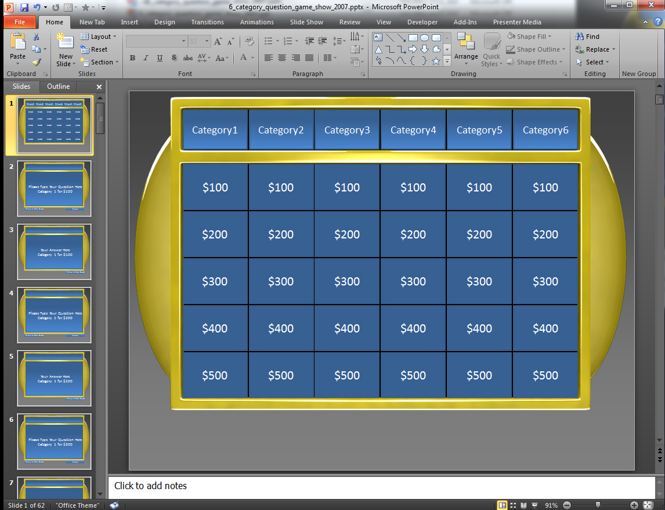
How to use this Template
This template is set up using hyperlinks which jump from slide to slide.
Each panel is linked to a corresponding Question slide which has a panel where you can edit the text and type in your own Question.
Under each Question Slide is an Answer Slide which you can type the answer to your Question.
Here is the Question Slide that contains an area to type your question.
Click the Answer button to jump to that Questions Answer Slide which is the slide directly below.
Here is the Answer Slide that is directly below the Question Slide.
You can also click the Return to Main Board button if you choose not to reveal the answer.
*note* You can access Slide Show Mode by hitting the F5 key on your keyboard or going to the Slide Show tab in your top menu and selecting From Current Slide.
On the Answer Slide click the Return to Main Board button to return to the main Category Board.

Slide 63
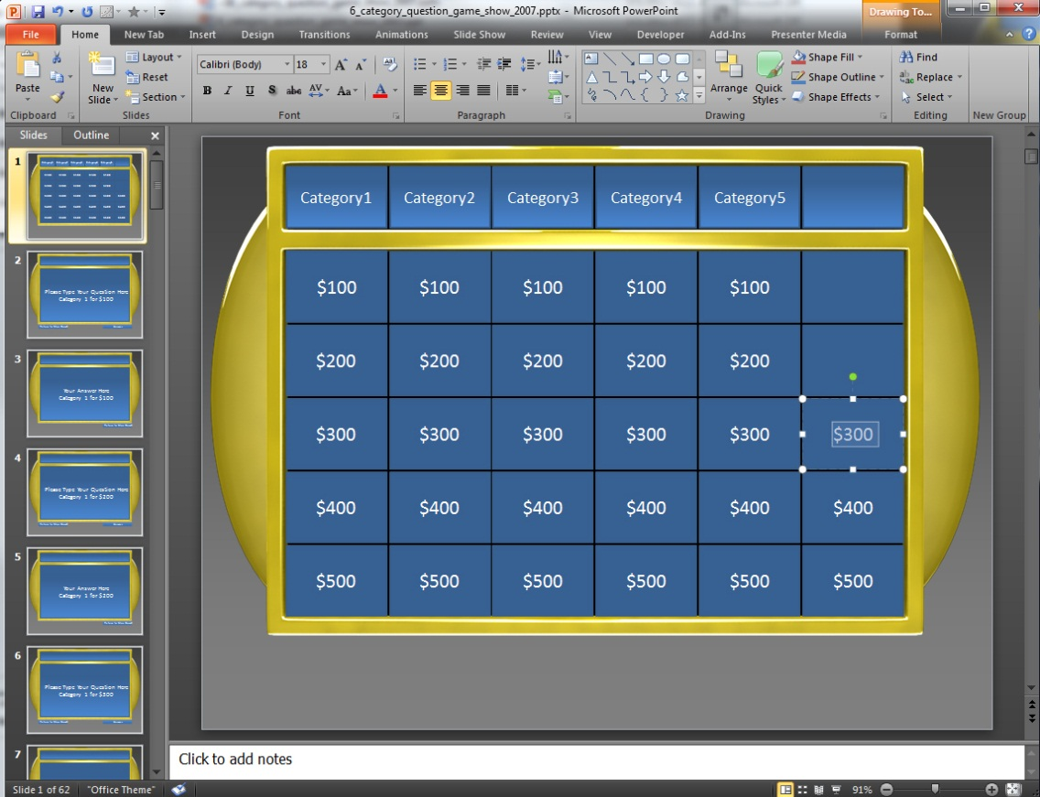
Making Panels Inactive
You can make panels inactive simply by selecting the TEXT and hitting delete which will leave the panel blank.
Once you have deleted the Panels you want you will want to go delete the corresponding Question and Answer Slides.
Example: If were deleted the text on these panels.
We would then need to go delete the corresponding Question and Answer Slides for Category4 $500, Category5 $500, Category6 $500.
*note*You can multiple slide at once by holding Shift while selecting slides.
Say if you wanted to delete all of Category6 Question & Answer slides you click the top slide you want to delete and hold shift and click the bottom slide and all the slides in between will be selected.

Slide 64
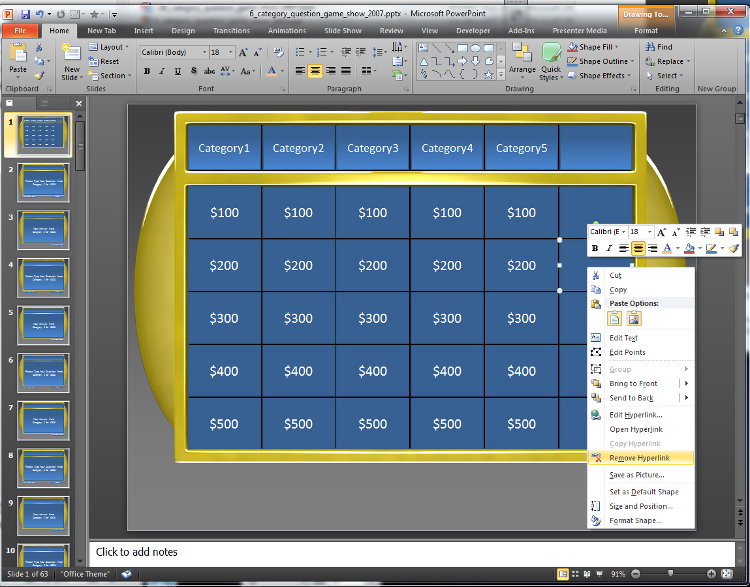
Making Panels Inactive Alternative
If you do not want to delete any of your slides Question and Answer Slides and just want to make those panels on the main board inactive, you can right click on the panel and select Remove Hyperlink.
For 2003 users you will need to double right click to find this option.
This will remove the link to the Corresponding Question Slide.

