Slide 1
Refusal Skills
Sex for Sale
Aggressive vs Assertive
STIs
Tech Talk
Birth
Control
$100
$100
$100
$100
$100
$100
$200
$200
$200
$200
$200
$200
$300
$300
$300
$300
$300
$300
$400
$400
$400
$400
$400
$400
$500
$500
$500
$500
$500
$500

Slide 2
What is one reason that saying “No!” can be hard?
Return to Main Board
Answer

Slide 3
You might be afraid of what they will think of you
Return to Main Board

Slide 4
What are two caring responses that help to say “NO”?
Return to Main Board
Answer

Slide 5
That’s flattering but…
It’s nice of you to offer, but…
Thanks for asking, but…
I’m glad you trust me to ask, but…
I love you, but…
I like you, but…
I care about you, but…
I’m sure you have a good reason for asking, but…
Return to Main Board

Slide 6
What are three ways to say “No!” in this situation? A friend wants to sneak out of the house.
Return to Main Board
Answer

Slide 7
Answers vary. One Ex :
I am uncomfortable leaving the house without telling my parents.
Return to Main Board

Slide 8
Choose four good ways to say “NO” from the Ways to Say NO.
List and tell why they are helpful
Return to Main Board
Answer

Slide 9
Answers Vary.
Possibilities include:
It’s not worth it
The response is firm and tells the other person that there is a risk.
Return to Main Board

Slide 10
What is a caring response in this situation: A friend hasn’t studied for a test, and asks you, “Can you let me cheat off of your test?”
What is your decision?
What is a consequence?
And what is an alternative that you can give your friend?
Return to Main Board
Answer

Slide 11
Did the answer include:
A Decision?
A Consequence?
An Alternative?
Ex: I won’t let you each off of my paper. We could both get Zeros on this test. Why don’t I help you study today at lunch?
Return to Main Board

Slide 12
What is pornography?
Return to Main Board
Answer

Slide 13
Any image that turns a person into a sex object or
Promotes sexual relations between children and adults or links sex and violence
Return to Main Board
Answer

Slide 14
What are some of the dangers of prostitution?
Return to Main Board

Slide 15
violence, poor self-esteem, fear physical and health problems and legal consequences
Return to Main Board

Slide 16
Who are people who are prostitutes and what are two reasons why someone might become a prostitute?
Return to Main Board
Answer

Slide 17
Women, men, girls, and boys can all be prostitutes.
The reasons are complicated. They include needing an income, being forced into prostitution, or could be way out of poverty.
Return to Main Board

Slide 18
Name two ways of making money from sex.
Return to Main Board
Answer

Slide 19
prostitution and pornography
Return to Main Board

Slide 20
What are three reason to avoid looking at pornography
Return to Main Board
Answer

Slide 21
It is addictive
It exploits people
You can’t unsee things
Return to Main Board

Slide 22
What are some examples of aggressive behavior?
Return to Main Board
Answer

Slide 23
Yelling, threatening or frightening others
Spreading rumors, gossiping,
Gossiping (talking about other people), spreading rumors (telling stories about other people
Creating or participating in groups that exclude others and influencing others to reject other people
Return to Main Board

Slide 24
Give four results of aggressive behavior?
Return to Main Board
Answer

Slide 25
Damaging to relationships
Aggressive people are difficult to be around
Arrest of the aggressor
Not the way Christians’ are called to live.
Return to Main Board

Slide 26
What is assertive behavior?
Return to Main Board
Answer

Slide 27
Confidently strong or
self-assured behavior
Return to Main Board

Slide 28
Name some common forms of assertive behavior.
Return to Main Board
Answer

Slide 29
Listening to other people
Respecting the thoughts and feeling of others
Making “I” statements when making requests
Using When, I feel statements: When you do ____________, I feel __________.
Being firm without attacking the other person
Return to Main Board

Slide 30
What are advantages of assertive behavior?
Return to Main Board
Answer

Slide 31
Relationships benefit when the interests and rights of other people are respected.
Develop Good interpersonal skills
Speak up when they see injustice.
Develop strong decision-making skills.
Learn more about themselves and learn to treat other with the respect that every person deserves.
Return to Main Board

Slide 32
What are STIs and two ways
to get STIs?
Return to Main Board
Answer

Slide 33
STI stands Sexually Transmitted Infection.
STIs are contracted by
touching of survival places and by Sexual Contact
Return to Main Board

Slide 34
Name four symptoms
of STIs
Return to Main Board
Answer

Slide 35
Unusual discharge (leaking of thick fluid) from the penis or vagina
Irritation, lumps or sores on or around the genitals
Pain or tenderness in the genitals, genital area or abdomen
Painful urination or frequent need to urinate
Return to Main Board

Slide 36
What is the best
prevention for STIs?
Return to Main Board
Answer

Slide 37
Responsible sexual behavior is the best prevention for STIs.
For young people, that means waiting until you are much older to become sexually active
Return to Main Board

Slide 38
What are four
common STIs?
Return to Main Board
Answer

Slide 39
Syphilis
Gonorrhea
Chlamydia
Genital Herpes
Return to Main Board

Slide 40
What do survival places and sexual contact mean in the context of STIs?
Return to Main Board
Answer

Slide 41
sexual contact: In order to pass the germ from on one body to another, there must be direct contact of STI survival places between two persons. This kind of contact generally happens during sexual activity.
touching of survival places: The germs that cause STIs need proper conditions to survive. Places in the body which are warm and moist, such as those found in places like the penis, vulva, rectum, mouth, or through
provide “survival places” for STIs
Return to Main Board

Slide 42
What is cyber bullying?
Return to Main Board
Answer

Slide 43
Bullying and aggressive behavior using technology is sometimes called cyber bullying. Cyber bullying is when people use technology like texting, emailing and posting to share offensive or hurtful pictures or comments about other people.
Return to Main Board

Slide 44
What are three ways a person can cyber bully using technology?
Return to Main Board
Answer

Slide 45
Send or text hurtful words or pictures
Post false or misleading stories to embarrass or ridicule others
Forward or share personal information without permission
Pretend they are other people online to trick others.
Spread lies and rumors about victims.
Trick people into revealing personal information.
Send or forward mean text messages.
Post pictures of victims without their consent.
Return to Main Board

Slide 46
What should people do if they are cyber bullied?
Return to Main Board
Answer

Slide 47
Save the messages and or pictures to show an adult
Tell a trust worthy adult: a parent, teacher, a counselor, or law enforcement officer.
Return to Main Board

Slide 48
What are three ways to stay safe online?
Return to Main Board
Answer

Slide 49
Do not forward offensive or inappropriate messages or images
Block people who share inappropriate images or words
Report cyber bullying to an adult
Never meet anyone in person that you only know online
Don’t share personal information about yourself, your friends or your parents online
Return to Main Board

Slide 50
What is the grandmother test?
Return to Main Board
Answer

Slide 51
Don’t post, text or email anything you wouldn’t want your grandmother to see
Return to Main Board

Slide 52
What is abstinence?
Return to Main Board
Answer

Slide 53
Abstaining from sexual intercourse. The most responsible thing a young person can do to prevent pregnancy
Return to Main Board

Slide 54
What is Birth Control and is it effective?
Return to Main Board
Answer

Slide 55
Any method to prevent pregnancy. Birth Control is not 100% effective, although some methods are more effective than others.
Return to Main Board

Slide 56
What are condoms and give two facts about condoms that people should know?
Return to Main Board
Answer

Slide 57
Also called, rubbers, are like very thick strong gloves.
Worn over the penis to catch the sperm.
Used once and thrown away
Only Birth control that can protect from STIs (other than abstinence)
Return to Main Board

Slide 58
What is “The Pill”?
Return to Main Board
Answer

Slide 59
Also known as oral contraceptives, these keep a woman’s ovaries from releasing eggs
Return to Main Board

Slide 60
What is “safer sex”?
Return to Main Board
Answer

Slide 61
Safe Sex is using protection for pregnancy and STIs.
A condom is the only way to protect against STIs. The Pill or Shot are the most effective birth control methods.
Return to Main Board

Slide 62
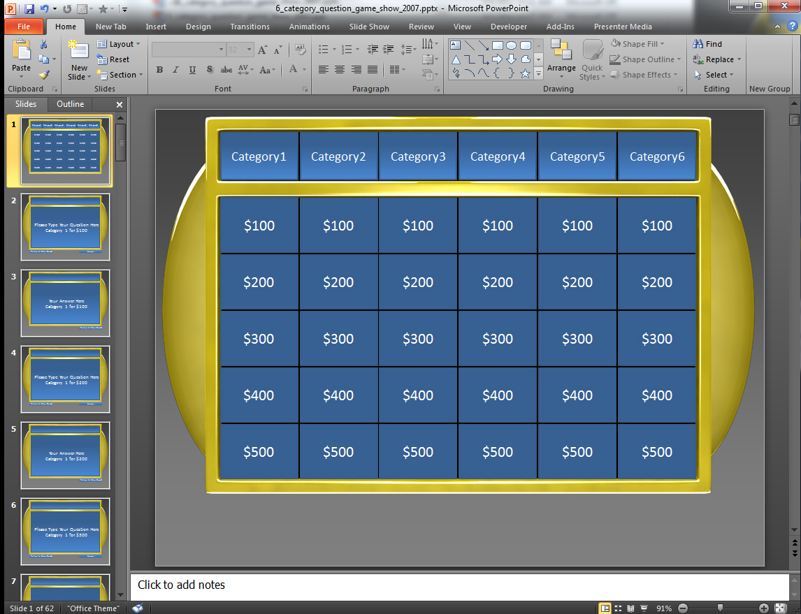
How to use this Template
This template is set up using hyperlinks which jump from slide to slide.
Each panel is linked to a corresponding Question slide which has a panel where you can edit the text and type in your own Question.
Under each Question Slide is an Answer Slide which you can type the answer to your Question.
Here is the Question Slide that contains an area to type your question.
Click the Answer button to jump to that Questions Answer Slide which is the slide directly below.
Here is the Answer Slide that is directly below the Question Slide.
You can also click the Return to Main Board button if you choose not to reveal the answer.
*note* You can access Slide Show Mode by hitting the F5 key on your keyboard or going to the Slide Show tab in your top menu and selecting From Current Slide.
On the Answer Slide click the Return to Main Board button to return to the main Category Board.

Slide 63
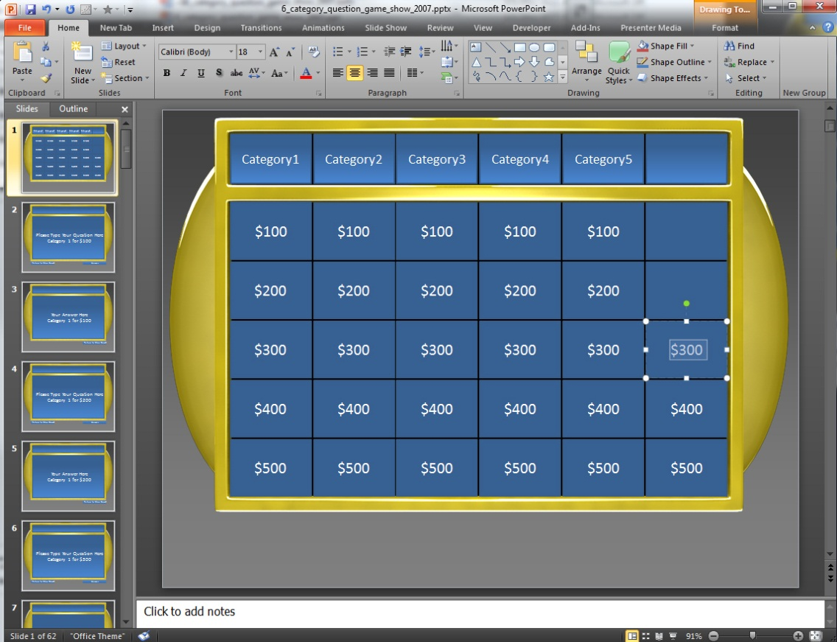
Making Panels Inactive
You can make panels inactive simply by selecting the TEXT and hitting delete which will leave the panel blank.
Once you have deleted the Panels you want you will want to go delete the corresponding Question and Answer Slides.
Example: If were deleted the text on these panels.
We would then need to go delete the corresponding Question and Answer Slides for Category4 $500, Category5 $500, Category6 $500.
*note*You can multiple slide at once by holding Shift while selecting slides.
Say if you wanted to delete all of Category6 Question & Answer slides you click the top slide you want to delete and hold shift and click the bottom slide and all the slides in between will be selected.

Slide 64
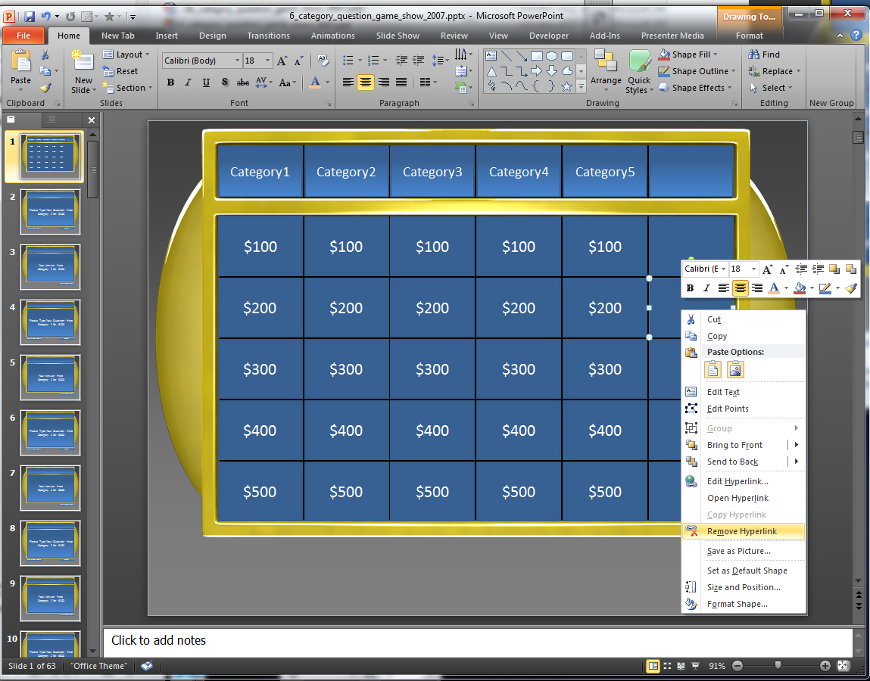
Making Panels Inactive Alternative
If you do not want to delete any of your slides Question and Answer Slides and just want to make those panels on the main board inactive, you can right click on the panel and select Remove Hyperlink.
For 2003 users you will need to double right click to find this option.
This will remove the link to the Corresponding Question Slide.

